Slide 1
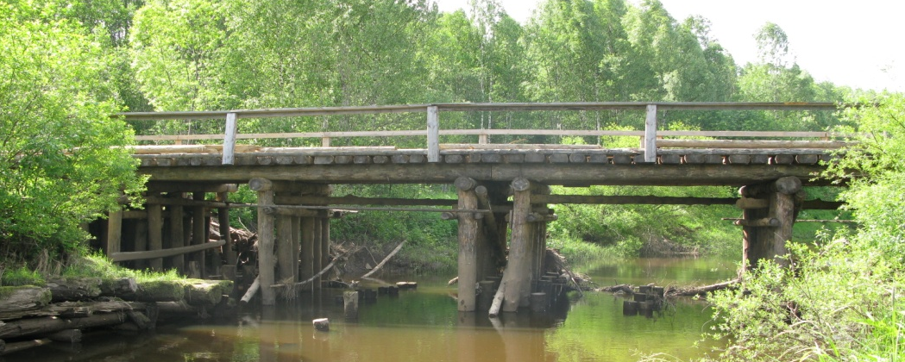
Russian–Swedish Co-operation in
Higher Forest Education and Training
Moscow, November 17th-18th, 2009
Block III co-operation partners:
Moscow State Forest University
St. Petersburg State Technical Forest Academy
Syktyvkar Forest Institute
Archangelsk State Technical University
Lisino Forestry College
SLU (Swedish University of
Agricultural Sciences)

Slide 2
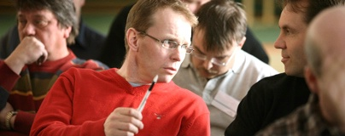
Russian–Swedish Co-operation in
Higher Forest Education and Training
Block III Objectives :
Development of training courses in 5 forest subjects for higher forest education
Aims in co-operation:
Development of Subjects’ curricula
Co-operation partners´ competence development
Development of education and training material

Slide 3

Russian–Swedish Co-operation in
Higher Forest Education and Training
Co-operation projects:
Use of Wood for Energy Purposes
Operational Planning of Logging and Wood Supply Operations
Accessibility of Forest Resources and Forest Road Network
Criteria and Indicators for Sustainable Forest Management
Forest Economics

Slide 4
Seminar program and objectives
Introduction
Projects’ dissemination
Experiences from co-operation
Implementation in new education
program
Applicability for continued education
Continuation of co-operation

Slide 5
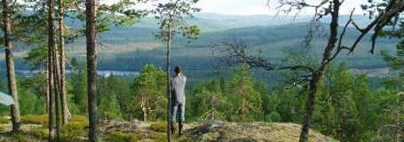
Greet you all welcome to the seminar
Leave the floor to our collegues

Slide 6
Seminar objectives
Dissemination of information on the work performed and the material developed
Exchange of experiences in the co-operation and lessons learnt for education and sector development
Plan for the implementation of the courses in the Russian forest education programs
Outline potential areas for continued co-operation
Define opportunities for a continued net working and co-operation between Russian and Swedish forest sector actors

